Slide 1
Database Systems
AICT005-4-1-Database Systems (version1)
Week 3: Data Model

Slide 2
Topic & Structure of The Lesson
Data model
Business rules
Relational model
Entity Relationship Model

Slide 3
Learning Outcomes
At the end of this topic, You should be able to
Describe types of data model
Write business rules
Understand entity relationship model

Slide 4
Key Terms You Must Be Able To Use
If you have mastered this topic, you should be able to use the following terms correctly in your assignments and exams:
Data model
Business rules
ERD

Slide 5
In this chapter, you will learn:
Why data models are important
About the basic data-modeling building blocks
What business rules are and how they influence database design
How the major data models evolved

Slide 6
The Importance of Data Models
Data models
Relatively simple representations, usually graphical, of complex real-world data structures
Facilitate interaction among the designer, the applications programmer, and the end user

Slide 7
The Importance of Data Models (continued)
End-users have different views and needs for data
Data model organizes data for various users

Slide 8
Data Model Basic Building Blocks
Entity - anything about which data are to be collected and stored
Attribute - a characteristic of an entity
Relationship - describes an association among entities
One-to-many (1:M) relationship
Many-to-many (M:N or M:M) relationship
One-to-one (1:1) relationship
Constraint - a restriction placed on the data

Slide 9
Business Rules
Brief, precise, and unambiguous descriptions of a policies, procedures, or principles within a specific organization
Apply to any organization that stores and uses data to generate information
Description of operations that help to create and enforce actions within that organization’s environment

Slide 10
Business Rules (continued)
Must be rendered in writing
Must be kept up to date
Sometimes are external to the organization
Must be easy to understand and widely disseminated
Describe characteristics of the data as viewed by the company

Slide 11
Discovering Business Rules
Sources of Business Rules:
Company managers
Policy makers
Department managers
Written documentation
Procedures
Standards
Operations manuals
Direct interviews with end users

Slide 12
Discovering Business Rules (continued)
Generally, nouns translate into entities
Verbs translate into relationships among entities
Relationships are bi-directional

Slide 13
The Evolution of Data Models (continued)
Hierarchical
Network
Relational
Entity relationship

Slide 14
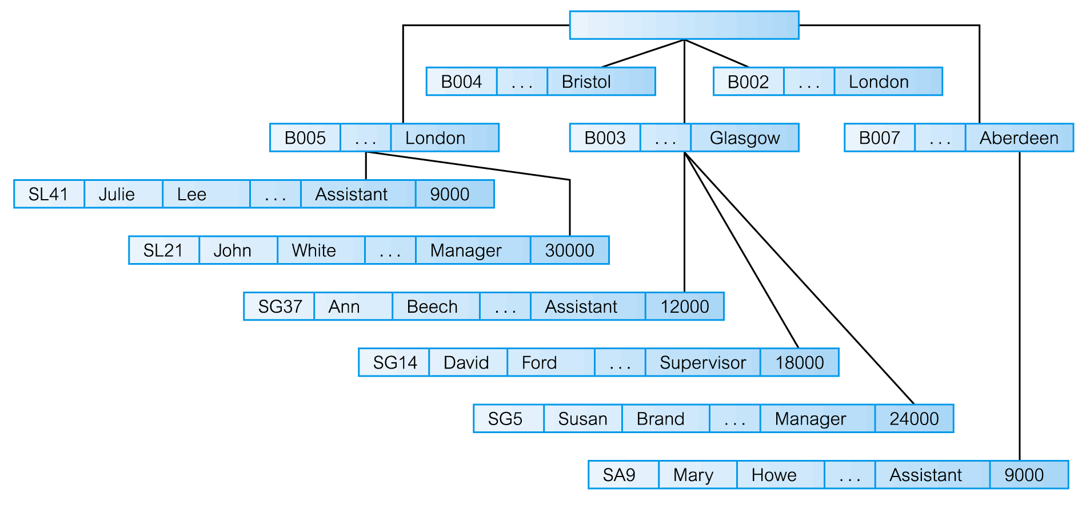
The Hierarchical Data Model

Slide 15
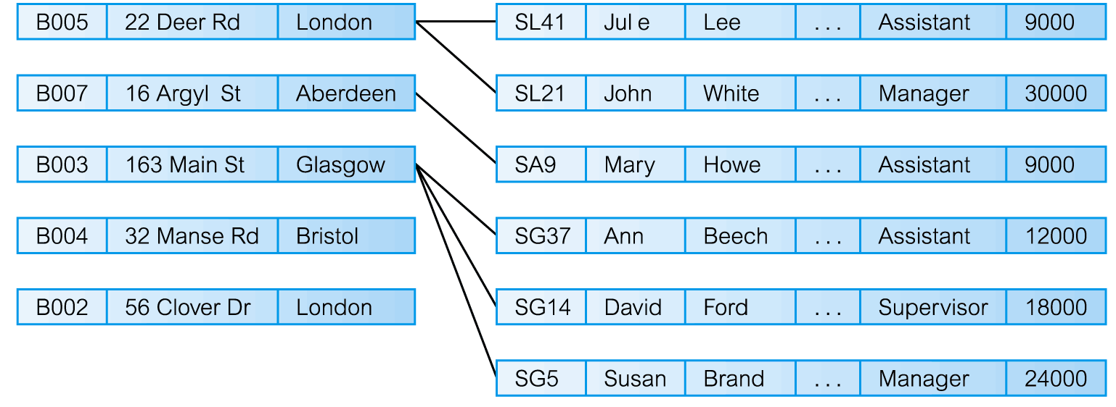
The Network Model

Slide 16
The Relational Model
Developed by Codd (IBM) in 1970
Considered ingenious but impractical in 1970
Conceptually simple
Computers lacked power to implement the relational model
Today, microcomputers can run sophisticated relational database software

Slide 17
The Relational Model (continued)
Table (relations)
Matrix consisting of a series of row/column intersections
Related to each other through sharing a common entity characteristic
Relational diagram
Representation of relational database’s entities, attributes within those entities, and relationships between those entities

Slide 18
The Relational Model (continued)
Relational Table
Stores a collection of related entities
Resembles a file
Relational table is purely logical structure
How data are physically stored in the database is of no concern to the user or the designer
This property became the source of a real database revolution

Slide 19
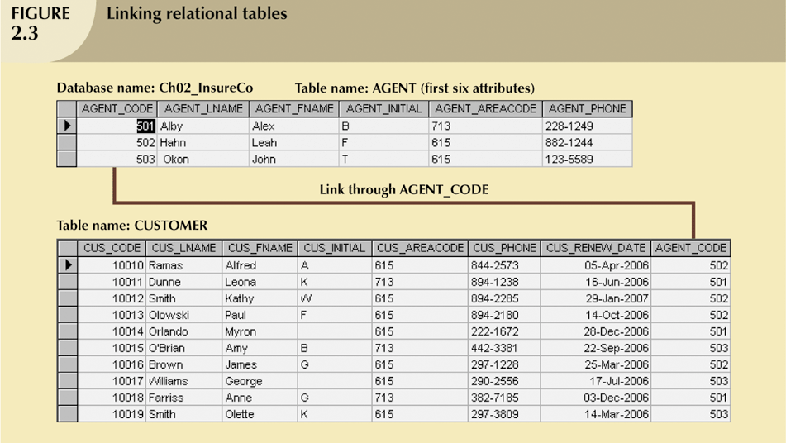
The Relational Model (continued)

Slide 20
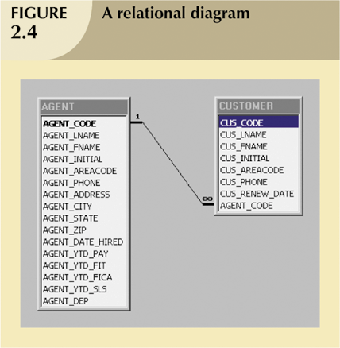
The Relational Model (continued)

Slide 21
The Entity Relationship Model
Widely accepted and adapted graphical tool for data modeling
Introduced by Chen in 1976
Graphical representation of entities and their relationships in a database structure

Slide 22
The Entity Relationship Model (continued)
Entity relationship diagram (ERD)
Uses graphic representations to model database components
Entity is mapped to a relational table
Entity instance (or occurrence) is row in table
Entity set is collection of like entities
Connectivity labels types of relationships
Diamond connected to related entities through a relationship line

Slide 23
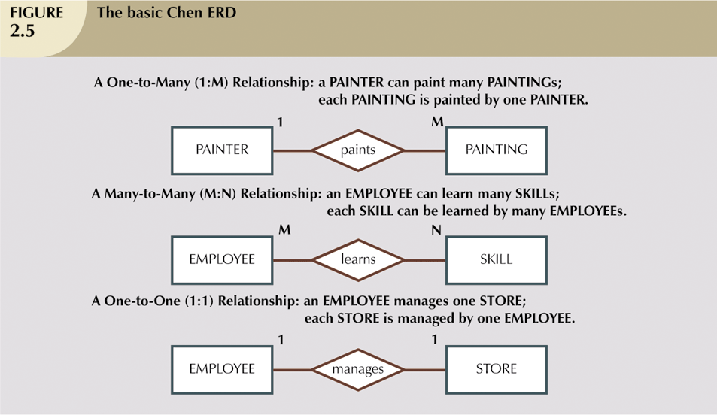
The Entity Relationship Model (continued)

Slide 24
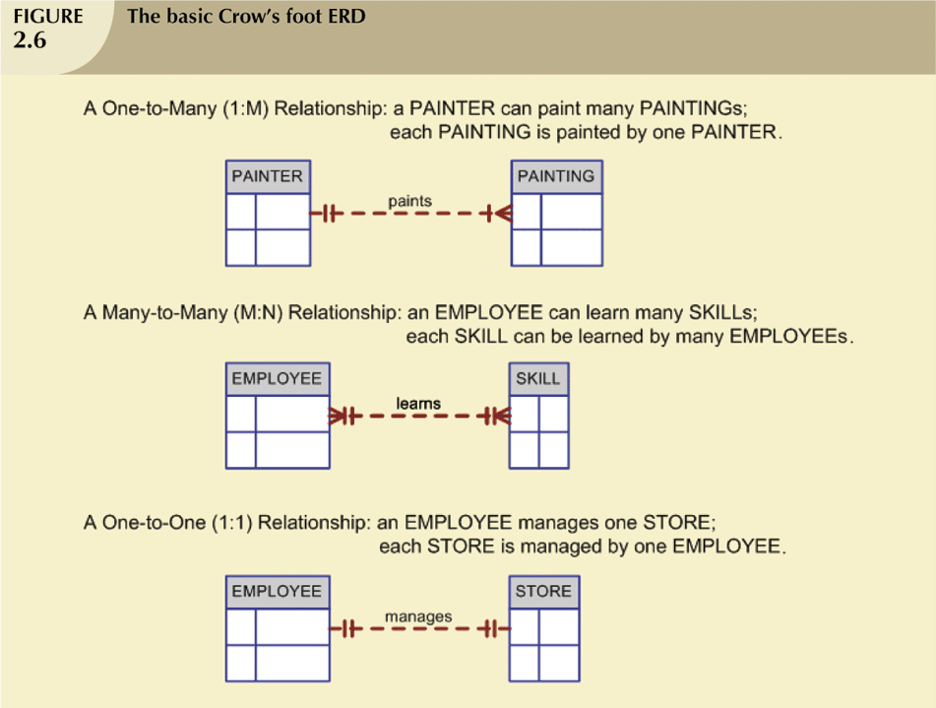
The Entity Relationship Model (continued)

Slide 25
Quick Review Question
What is data model?
What is the source of business rules?
What is entity relationship model?

Slide 26
Summary of Main Teaching Points
Data models are simple representations, usually graphical, of complex real-world data structures
Business rules are brief, precise, and unambiguous descriptions of a policies, procedures, or principles within a specific organization.
Entity relationship models are graphical representation of entities and their relationships in a database structure

Slide 27
Question and Answer Session
Q & A

Slide 28
What we will cover next
Characteristics of relational table
Different types of keys
Integrity rules
Data dictionary

